Slide 1
Team of Teams
Digital Experience 7/27/2021

Slide 2
Goal of Meeting
Team of Teams is a 50-minute weekly meeting in which a representative from each team building on or in support of VA.gov gives a quick update on their team’s work. The goal is for teams to have the general awareness needed to support each other, collaborate, or draw learnings to apply to their own work – ultimately nurturing the creation of more great Veteran-facing services (VFSs).
If you’re the representative for your team today, you have 2 main jobs in this meeting:
1) Give a one-minute update on your team’s work
2) Note relevant updates from others and share with your team afterward
We encourage discussion in Slack during the meeting, so start up threads in the #vfs-all-teams Slack channel as needed, and Andrea will help moderate.
Thanks! Let’s get started…

Slide 3
Agenda

Slide 4
Agenda
Platform Crew
FE Tools Team
BE Tools Team
Testing Tools Team
Operations Team
CMS Core Application Team
Service Design Team
Product Support Team
Analytics & Insights Team
Content & IA Team
Lighthouse API Team
Sitewide Crew
Facilities Team
VAMC Web Modernization Team
CMS Product Support Team
Public Websites Team
Search & Discovery Team
Decision Tools Team
Content & Localization Team
Design Systems Team
Sitewide Content
Account Experience Crew
Authenticated Experience Team
Identity Team
Contact Centers Team
VA Digital Notifications Team
Virtual Agent/Chatbot
Health Tools Crew
Health Care Experience Team
Online Scheduling Team
Caregivers Team
Benefit Tools Crew
eBenefits Team
Claims & Appeals Team
Debt Resolution Team
Education Application Team

Slide 5
Platform Crew

Slide 6
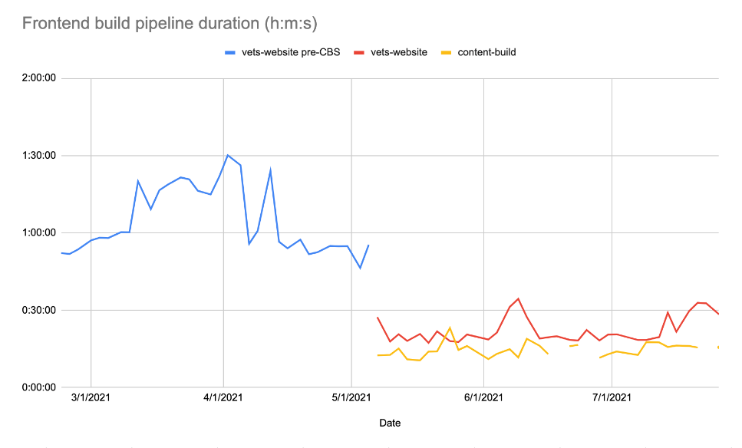
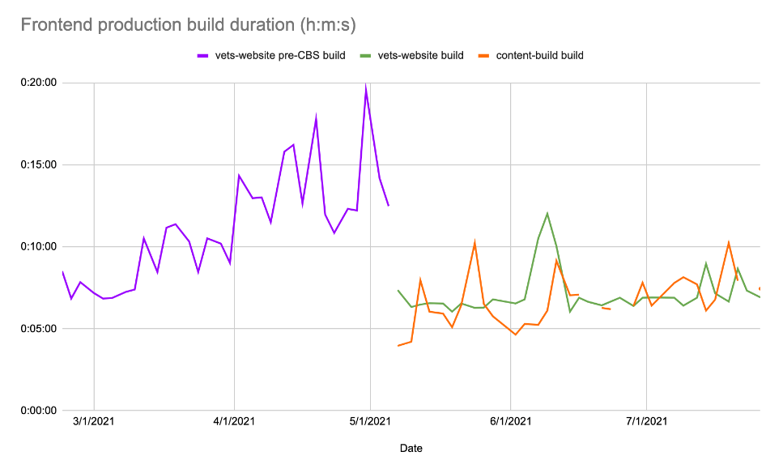
Frontend Tools
TEAM REPRESENTATIVE: Megan Kelley / OCTO-DE LEAD: Mike Pritchard
Insights:
Sprint 56 (7/8/21 – 7/20/21)
Slack support request count: 16
frontend-review-group PR reviews: 28
Frontend build times
Mission: Provide superior tools and infrastructure to VFS frontend teams that enable autonomous product development while meeting Platform standards for quality and consistency.
No updates for this group
N/A
Dependencies, blockers
N/A
Q&A:
TBD

Slide 7
Backend Tools
TEAM REPRESENTATIVE: Jeff Dunn / OCTO-DE LEAD: Dror Matalon
Insights:
7/21/21 – 7/27/21
PR Reviews
54 reviewed by backend-review-group
Major updates
BE Tools will be doing an off-cycle deploy between 3-4am ET on Thursday morning to rotate session keys. We need to deploy during the time of lowest traffic to avoid issues with the rolling deploy when new/old instances are briefly up at the same time.
Any changes merged after the 2pm ET deploy tomorrow (Wednesday) will be deployed early Thursday morning.
In the future, session keys will be automatically rotated monthly. For now, it's a manual process.
Dependencies, blockers
None.
Q&A:
TBD

Slide 8
Operations
TEAM REPRESENTATIVE: Jesse House / OCTO-DE LEAD: Dror Matalon
Mission: Enable the VA to build digital tools at scale that improve Veterans’ lives.
Incident - All Jenkins deployments failed due to GitHub API rate-limiting - Friday, July 23, 2021
Technical issue prevented deployments of Content, Website, and API
Deployments began working ~1015 ET Monday 7/26
While the incident didn't directly affect veterans...
It did affect content editors which are customers of the platform's services
Team effort to track down and resolve the issue - Thank you!
Add'l technical details to be provided in post-mortem documentation
Thank you all for your patience!
Sentry - Loss of historic events, continued performance issues - Monday, July 26, 2021
The EKS cluster that hosts Sentry had a catastrophic event - announcement in Slack from Demian Ginther HERE
A persistent storage volume was lost that contained historic events
Looking into ways of restoring these events, but it is possible that the events will not be recoverable.
Immediately implementing backups on any persistent volumes that EKS automatically creates.
The ops team knows that you rely on this data, and we are sorry for the data loss. If we can recover the data, we will.
We are also continuing to work on performance issues, and have had some fantastic help and suggestions from other teams
Ops Office Hours meetings - NEW TIME!
We've moved Ops Office Hours (OOH) meetings to 1300 ET
Hopefully this better accommodates platform crew and VFS teams scheduling
See you there! Zoom Link
Dependencies / Blockers:
None
Q&A:
TBD

Slide 9
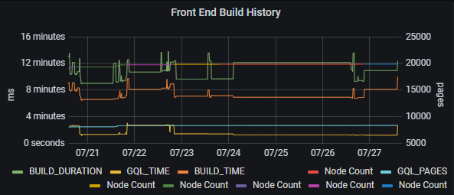
CMS Core Application - 7/27/21
TEAM REPRESENTATIVE: JEFF BRAUER / OCTO-DE LEAD: MIKE CHELEN
Value Metrics (past 7 days)
Users
# Active users: 373 [ ↑3 ]
Content:
Published node total: 19,757 [↑945]
Front end build data
Mission: VA’s CMS implementation is a best-in-class, de-coupled content-API, that meets the needs of editors, application development teams, and all consuming applications.
Accelerated Publishing
Presented Accelerated Publishing Executive Summary to OCTO-DE, and will be scheduling 1 more general review and 1 more technical review
Gov Delivery
Now using production endpoint!
Q&A
Average GraphQL Response Time: ~2.78 minutes
Average Build Duration: 12.86 minutes

Slide 10
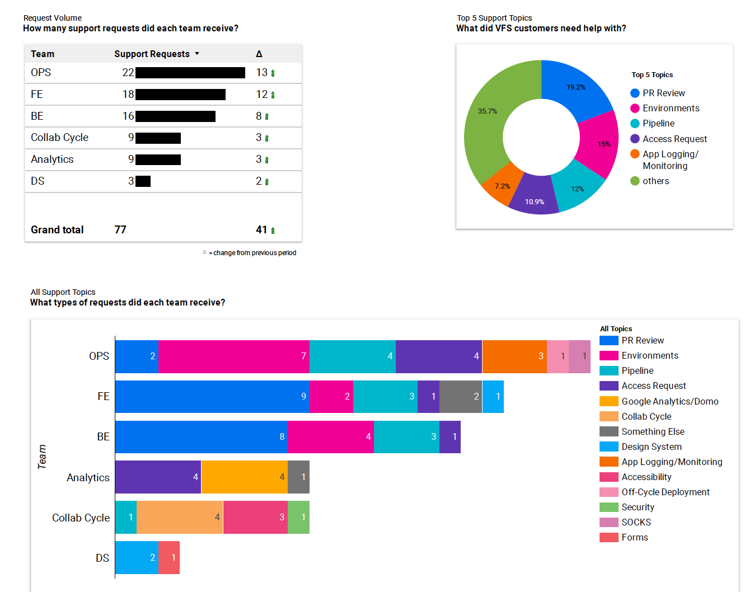
Service Design
TEAM REPRESENTATIVE: James Chasia / OCTO-DE LEAD: Rachael Roueche
Insights:
Platform Customer Support Slack Requests 7/19 - 7/23
Mission: Provide holistic, research-based guidance on Platform design and product decisions that empower VA.gov development teams to build digital services at scale that work for Veterans and their families
No updates
Q&A:

Slide 11
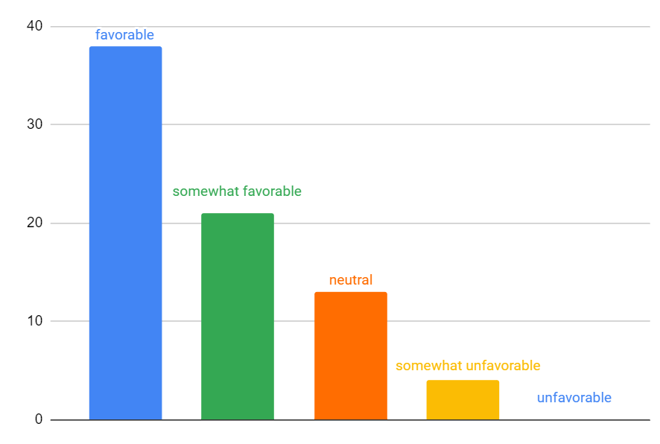
Platform Product Support
TEAM REPRESENTATIVE: Shira Goodman / OCTO-DE LEAD: Rachael Roueche
Insights:
Collaboration Cycle Favorability at Staging Review
*As of 7/16/2021
Collaboration Cycle Touchpoints Sprint 56:
Mission: Provide expert design, content, information architecture, quality assurance, accessibility and product guidance to VFS teams to ensure their applications are consistent, compliant and meet the quality standards set by OCTO for VA.gov.
Pilot of new Staging Review process is still in progress
Decision Tools (7/2) ✓
Caregivers (7/15) ✓
Healthcare Experience (7/29)
Moving Collaboration Cycle guidance over to Platform Website
Preparing for release/launch of:
VA.gov Experience Standards
WCAG 2.1 updates (w/ Testing Tools Team)
Accessibility test cases in TestRail (w/ Testing Tools Team)
Collaboration Cycle Office Hours - Wednesday 11:30am-12:00pm ET (Check CC Calendar for Zoom info)
Design Intent | 1
Midpoint Review | 2
Staging Review | 1
IA Request | 1
508 Audit | 1

Slide 12

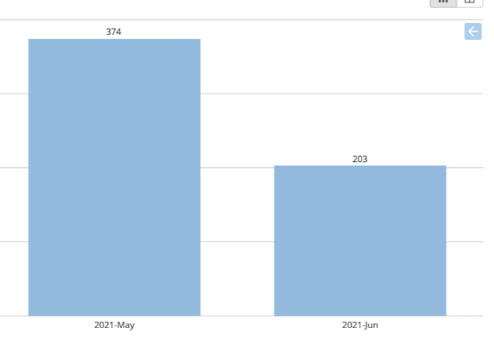

Analytics & Insights
TEAM REPRESENTATIVE: Joanne Esteban / OCTO-DE LEAD: Mike Pritchard
Insights: Week of 7/27
Service Completion
Monthly Domo Page Views: 45.7% ⬇️️
Coming Soon:
Monthly Active Domo Users
Health
Google Tag Manager implementation completed: 2
Google Tag Manager implementation in progress: 11
Coming Soon:
Days to Complete
Mission: Empower Veteran Facing Services teams to make more data-informed decisions for better Veteran outcomes.
Updated Analytics products and services
Search & Content KPI Dashboards launched 7/21!
Please see our customer support guide for more information on how our team is supporting analytics questions.
Updated Office Hours:
Analytics Office Hours – Tuesdays 3:30-4pm ET
Collaboration Cycle Office Hours – Wednesdays 11:30am-12:00pm ET
Analytics Office Hours– Thursdays 12:30-1pm ET
Dependencies, blockers
None
Q&A:

Slide 13
TEAM REPRESENTATIVE: Liani Lye / OCTO-DE LEAD: Rachael Roueche
Insights:
Week of July 26, 2021:
Platform Website:
Users: 0 (releasing to 1 VFS team in June ’21)
Pageviews: Coming soon
Time spent per page: Coming soon
Sentiment: Coming soon
Week of July 19, 2021:
Platform Website:
Users: 0
Pageviews: Coming soon
Time spent per page: Coming soon
Sentiment: Coming soon
Content & IA
Mission: Provide expert content and IA support and resources to VSP and VFS teams to ensure that content in the VA.gov and platform ecosystem is easily findable, error free, and written in plain language.
No updates.
Q&A:

Slide 14
Lighthouse API Team

Slide 15
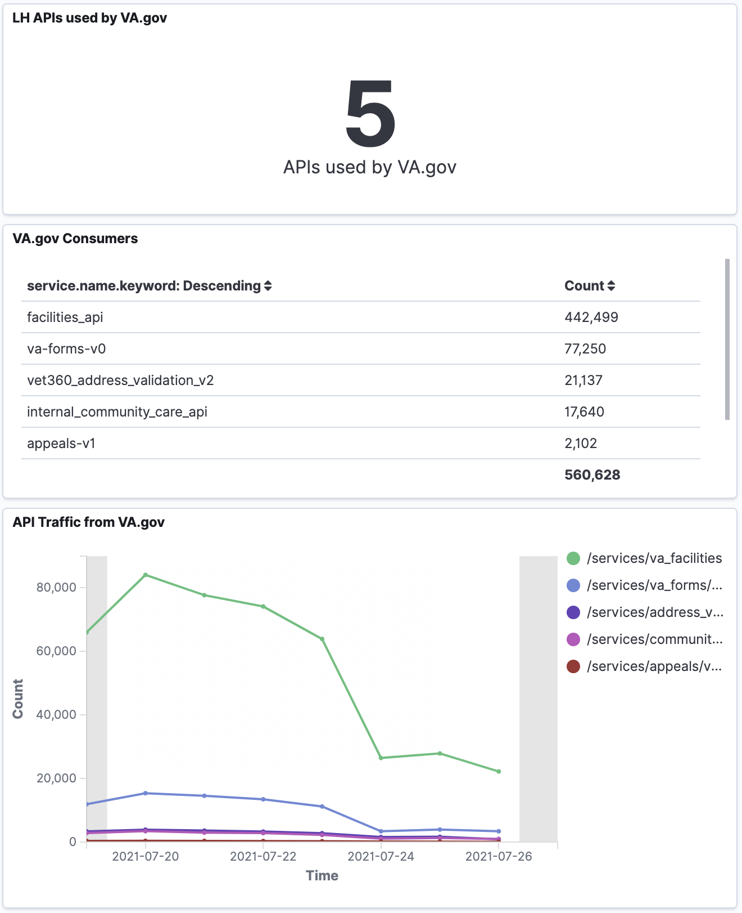
Lighthouse API Platform
TEAM REPRESENTATIVE: Kathy Turney
Mission: To provide a world-class Application Programming Interface (API) platform that powers a modern digital experience for Veterans, their families, and their advocates while simultaneously simplifying access to VA data and services.
Insights:
Updates
Patient Generated Data (PGD)
Confirmed connectivity with test PGD database in VA's Data and Analytics Product Line (DAPL) environment
Acquisition request now started within VA to host the LightHouse PGD database in DAPL environment
Dependencies, blockers
None

Slide 16
Sitewide Crew

Slide 17
Facilities
TEAM REPRESENTATIVE: Michelle Middaugh / OCTO-DE LEAD: Dave Conlon
VAMC Insights
Month of June 2021
Mission: Connect Veterans to VA locations where they can receive services
Facility Locator
Screen reader usability synthesis is complete - now prioritizing findings
Dependencies, blockers
Waiting for new provider group logic data set (PPMS POC)
VAMC
Wrapping up discovery for Domiciliaries and Community Living Centers
Completing mobile synthesis
Supporting VAMC go-live
Vet Centers
6 of 10 MVP Vet Centers launched
1st location in District 5 in review
Revisiting Vet Center alert design
Buttons with highest engagement
View all health services
Make an appointment
See all locations
Register for care
Pharmacy
Accordions with the highest engagement
Mental health
Parking
Primary care
Transportation services
Visitor hours and information
Link with the highest engagement: In the Spotlight

Slide 18
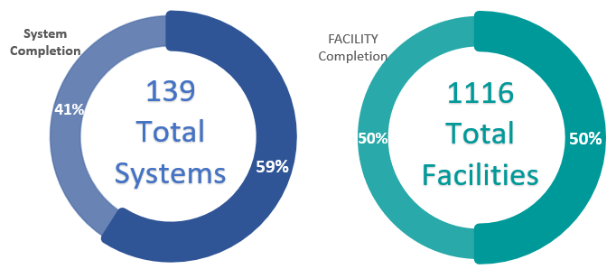

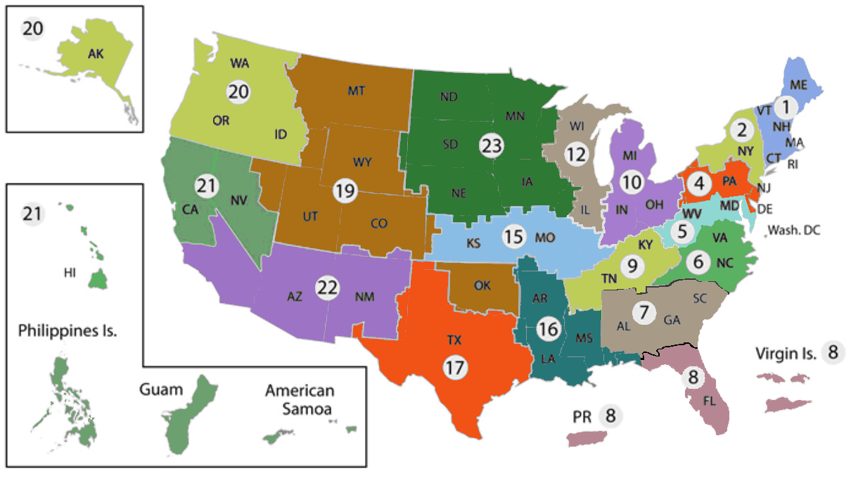
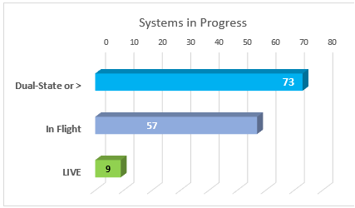
VAMC – Web Modernization
TEAM REPRESENTATIVE: Stan Gardner/ OCTO-DE LEAD: David Conlon
Insights:
Mission: Provide to Veterans accessing the VAMC websites a user experience that provides solutions to key touch points in the end-to-end Veteran healthcare journey.
- - Coatesville-health-care, Northern-California-health-care, Minneapolis-health-care, and St.Cloud- health care, are now live!
Go Live/full production: (Awareness for CMS, Facilities, Platform, Public Websites, Front end tools)
Wednesday July 28th, syracuse-health-care/, salt-lake-city-health-care/, new-jersey-health-care/, oklahoma-city-health-care/
Wednesday Aug.4th, western new york health care; salem health care; asheville health care; salisbury health care; alexandria health care; shreveport health care; southeast health care; louisiana health care; gulf coast health care; sierra nevada health care
Dual state Launches: (Awareness for CMS, Facilities, Platform, Front end Tools)
7/27: https://www.va.gov/so-oregon-health-care/ https://www.va.gov/spokane-health-care/,
7/28: https://www.va.gov/walla-walla-health-care/,
In Queue:
8/3: https://www.va.gov/ann-arbor-health-care/, https://www.va.gov/battle-creek-health-care/
8/4: https://www.va.gov/central-ohio-health-care/, https://www.va.gov/chillicothe-health-care/
Dependencies, blockers
Dependency: Working with CMS to migrate last six VAMC System and Health Services
Dependency: Mobile facility research and creation (Specific Systems pushed back in schedule )
Dependency: Node capacity in GraphQL/CMS – Monitoring
Q&A:
TBD
Any launches to announce? Copy and paste this celebration icon
next to the update!

Slide 19
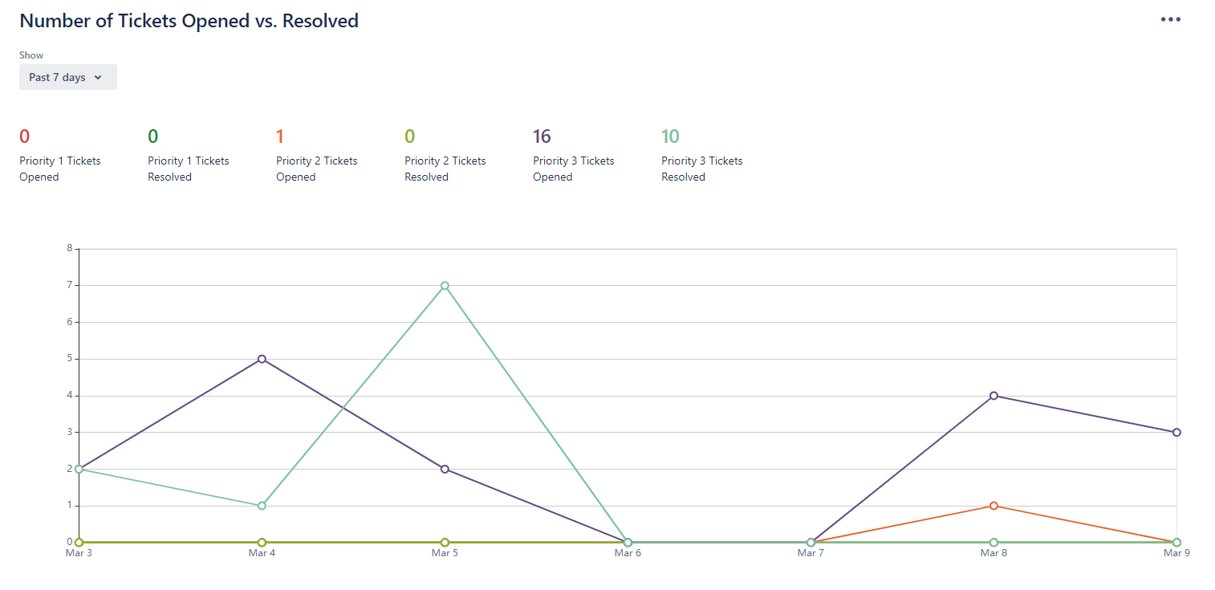



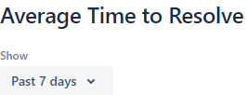

CMS Product Support - 7/27/21
TEAM REPRESENTATIVE: CLARENCE MAENG / OCTO-DE LEAD: DAVE CONLON
Insights:
Products with CMS managed content:
# of VFS products supported: 10
# of shared content libraries: 3
Helpdesk data
Mission: VA’s CMS implementation is a best-in-class, de-coupled content-API, that meets the needs of editors, application development teams, and all consuming applications.
Vet Centers
Support for Vet Center launches
VAMC
Support for full production launches
Migrating remaining health services for last 6 VISNs
General
Rebranding of the CMS Knowledge Base
Dependencies, blockers
None
Q&A:
TBD

Slide 20

Public Websites
TEAM REPRESENTATIVE: BRIAN LLOYD / VA LEAD: JOHN HASHIMOTO
Value Metrics: Campaign Landing Page (CLP) COVID-19 Vaccine
Findability:
29K Page Views
Top Traffic Sources: 1. Direct VA.gov Campaign, 2. Bing Search – Referral
Service Completion
“What can you do/Learn More from Trusted VA providers” CTA conversation rate was 55.78% so far for the month of July 2021.
Mission: Provide Veterans, family members, caregivers, and other audiences access to vital information and tools in support of VA benefits and services.
Harassment Reporting Tool (HRT) – Team is working HRT landing page / form design mockups with Stakeholders. Completed Design intent review with plans to work any applicable tickets and recommendations forward. Next steps: Finalize design mocks ISO FE prototype build.
Campaign Landing Pages – Team is working CLP request from Veterans Experience Office (VEO) – Virtual Enrollment Fair initiative. Team continues to work Post MVP 1.0 updates/tweaks as needed.
Resources and Support: Team is working 508 defects along with meta title tag styling updates.
*Note: PW avoids Friday/Weekend deploys. Requests should coincide with M-Th launches.
Intake Requests: None to mention
Redirect Request : Vet Center MVP pages (#25885, Status: In-Progress (pending validation from Facilities team for go-live)
Dependencies, blockers: None
Q&A: Tabelet is the dark blue category
Any launches to announce? Copy and paste this celebration icon
next to the update!

Slide 21
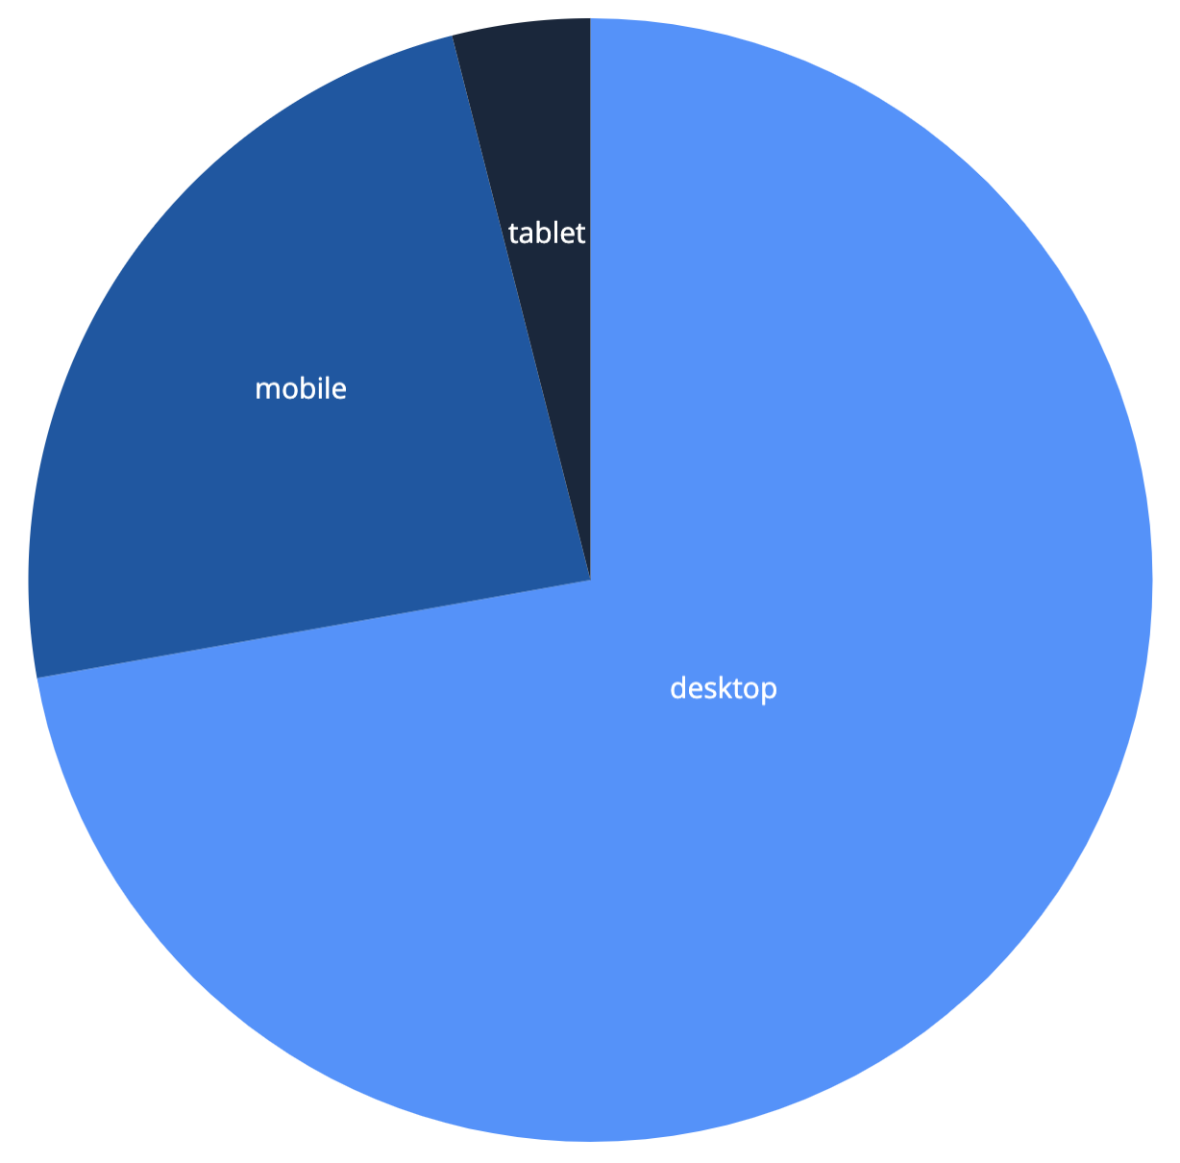
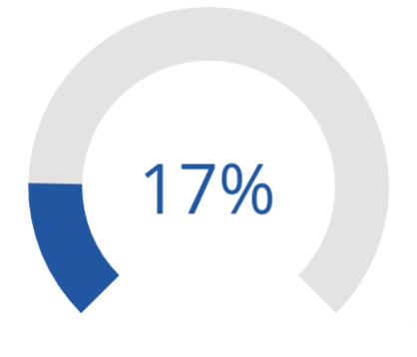
Search & Discovery
TEAM REPRESENTATIVE: DENISE COVEYDUC / OCTO-DE LEAD: JOHN HASHIMOTO
Insights:
*Search Domo Dashboard is now available. Evaluating available metrics; more insights to come.
Search Clicks by Device
Jan 1- Jul 24, 2021
Search Refinement Rate
Jan 1- Jul 24, 2021
Mission: Enable Veterans to find the essential information, tools, and services they need as easily and quickly as possible on VA.gov
Surfacing Search Tools / Search Landing Page
Finalized research plan for usability study
Creating high fidelity designs ahead of Midpoint review
Typeahead 2.0 (Drop Down Component)
Creating initiative brief ahead of collab cycle kickoff
Working with accessibility team to account for requirements in engineering scope
VA Video Results
Completed initial exploration to integrate videos into search results; highlighting the need for a new endpoint for Video API.
Creating initiative brief ahead of collab cycle kickoff.
Dependencies, blockers
None
Q&A:
TBD
4%
24%
72%

Slide 22
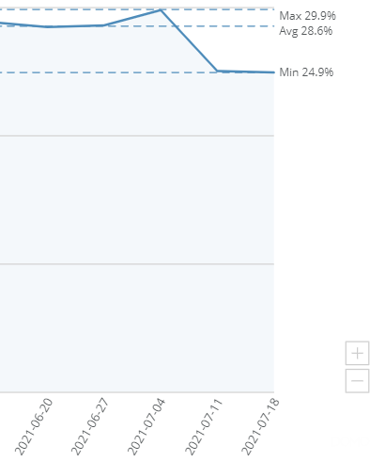
Decision Tools
TEAM REPRESENTATIVE: MARCI MCGUIRE / OCTO-DE LEAD: JOHN HASHIMOTO
Find a VA Form Insights:
Ease of Use
As reported last week, search refinement rate has remained relatively flat (29-31%) since the tool launched a year ago. Since our last release on July 7, refinements have fallen to 24.9%.
Mission: Provide Veterans, family members, caregivers, service members and other audiences access to the tools they need to make decisions about services to which they are entitled.
Find a VA Form:
Held two pilot research sessions last week to test effectiveness of PDF download info
Based on feedback from pilot sessions, we produced one other option
User test sessions are scheduled for July 27-30
Discharge Upgrade Wizard:
Deploying a content change this week
Mapping out user flow for larger update starting sprint 53
Dependencies, blockers
None
Q&A:
TBD

Slide 23
Content & Localization
TEAM REPRESENTATIVE: Sharon Kasimow / OCTO-DE LEAD: Danielle Thierry
Mission: To provide limited English proficiency (LEP) Veterans and their family members (including family caregivers) access to essential health and benefit information online in their native language
Insights:
Top 3 Click Events for Spanish page
#1 : Applications for VA benefits and resources available in Spanish
#2 Download Language ID Card
#3 How to get free language assistance from VA
Language Assistance & Resources pages
Spanish survey live in production
Working on 508 defect request from the Full Accessibility & 508 Office Audit
Updating Unit Test for footer link and pages
Enterprise Translation Recommendation
CMS sandbox explorations for relating page nodes to each other complete (for translated content)
Reviewing with CMS engineering
Implemented CMS sandbox example of “Other Language” page to demonstrate multiple language sections on one page with jumplinks can be supported
Dependencies / Blockers
None

Slide 24
TEAM REPRESENTATIVE: Carol Wong / OCTO-DE LEAD: Kevin Hoffman
Design System Team
Mission: Provide simple, scalable, high quality tools and guidelines that enable teams to rapidly build and improve the Veteran facing digital applications provided by VA.
Updates
No update this week.
Dependencies, blockers
none
Q&A:
Insights:
Component Usage (6 most used)
Alert Box 91 (-19)
Loading indicator 133 (+1)
Telephone Contacts 139 (+3)
Additional info 68 (+1)
Radio Buttons 44
Modal 44
Web Components
Total = 33 (+50)
Alert 67 (+47)
Accordion 16 (+3)

Slide 25

Sitewide Content
TEAM REPRESENTATIVE: Randi Hecht / OCTO-DE LEAD: Beth Potts & Danielle Thierry
Insights:
New Resources and Support pages since launch: 32
Topic areas: 8
Total articles: 57
Mission: To build trust by giving all Veterans and their family members the information they need to understand, access, and manage their VA benefits and services—using a single, plain-language VA.gov voice
Sitewide updates
Fixed broken links to PDF on records page
Continuing intent to file work
Resources and Support
Published 2 articles—first in Disability section
Product support
Moved widget and completed all entry points for Form 526 in disability
Made updates to COVID-19 CLP (Delta variant and new video)

Slide 26
Account Experience Crew

Slide 27
Authenticated Experience
TEAM REPRESENTATIVE: ANA JAKABCIN/OCTO-DE LEAD: SAMARA STRAUSS
Insights:
My VA 2.0 has been live to 100% of users for ~2 weeks
Objective: Update My VA so that it provides more direct, personalized routes to Veterans’ most critical updates and tasks.
Key Result #1 — Usage: Increase % of logged-in users visiting My VA from 6% pre-My VA 2.0 to 8% post-My VA 2.0 by Q3
Baseline from Q1 6% and 13%, respectively
Mission: To elevate Veterans’ personal and benefit information on VA.gov so that they can more easily understand their statuses and complete necessary tasks.
My VA
Prepping to submit for accessibility office review
Adjustments to GA tracking implementation
Notification Preferences
Continuing build
Working on test plan and test documentation with partners on VA Notify and VA Profile
Action Items Discovery
Continuing work on prototype for user research
KPI/Metric | First ~2 weeks at 100% (As of 5pm 7/26)
% of logged-in users who visit My VA | 8%
% of logged-in users interact with the homepage | 19%

Slide 28
Identity
TEAM REPRESENTATIVE: Christine Dillman / OCTO-DE LEAD: Cory Trimm
Insights for week of 7/19-7/25:
SSOe Inbound –
Deployed to 100% of Production Users
Success Rate: 97.3%
SSOe Outbound:
Deployed to 100% of Production Users
Success Rate:
Id.me: 65.1%
MVH: 68.6%
dslogon: 69.2%
Mission: To ensure that the correct users can simply, reliably, and securely access only the services and data they are permitted to access. (WIP)
Updates:
No new updates this week. Business as usual.
Dependencies, blockers:
IAM: SR-005643 – MPI attribute request
IAM: SR-005955 – Login.gov Integration with eAuth
ID.me: Login experience improvements are being delayed due to ID.me working on other contracts outside of the VA – Delayed until August
CTO: Authority to Operate (ATO) for Login.gov
Q&A:

Slide 29
Contact Center
TEAM REPRESENTATIVE: Jason Woodman / OCTO-DE LEAD: Chante Lantos-Swett
Insights:
All data is for White House VA Hotline aka VEO (Veterans Experience Office) Contact Center for the last 7 days.
No update this week
Mission: Facilitate the sharing of data and information between VA Contact Centers and VFS teams to ensure VA.gov users’ issues and feedback are swiftly resolved through customer support channels and product enhancements.
No updates this week.
Dependencies, blockers
N/A
Q&A:
TBD

Slide 30
VA Digital Notifications
TEAM REPRESENTATIVE: Paras & Tim / OCTO-DE LEAD: Beverly & Shane
KMI Dashboard
Mission: Facilitate an excellent communications experience from VA Business Lines to Veterans across any digital channel.
[VANotify + VEText] COVID-19 Keep Me Informed (KMI) Initiative
Last week, no Keep Me Informed (KMI) email was sent to Veterans
[VEText] Pharmacy Shipment Notifications
Pilot: Two (2) sites – Asheville, NC and Denver, CO
Confirmed funding for VISN 6 expansion; working with VA Notify to make sure we are ready to expand pilot (i.e., short code, message templates, etc.)
[VEText] Authority to Operate (ATO) Renewal
In Progress: Updating VEText documentation and controls in eMASS
[VANotify] Self Service Portal
In Progress: Designing the governance process
In Progress: Template status, template details & analytics
Done: Deployment of the UI to both Staging and Production
Done: Improving authentication error messaging
The team continues working through the beginnings of the SSOi implementation approval process
[VANotify] Notifications & Business Progress
Done: Pointing our load tests to the performance environment
Met with the OCC to discuss a possible integration with VANotify for both email and SMS use cases
Pharmacy Shipment - # Messages
Asheville, NC 11,623
Denver, CO 15,178

Slide 31
Virtual Agent/Chatbot
TEAM REPRESENTATIVE: Ian Santarinala / OCTO-DE LEAD: Luciana Morais
Insights:
Mission: Enable veterans to self-serve by providing them with a tool to interact with the VA at any time of day and more directly access the dense content available on VA.gov
Where we are at
Continuing Phase 2 strategy workshops. Completed Elevator Pitch, Content Management, Technical Architecture, Cross Functional Requirements, Metrics and KPIs, Product Roadmapping, and Tshirt size estimation activities
What we’re doing now
Scheduling deeper dive discovery meetings with specific groups
Conducting Ways of Working sessions with our various stakeholder groups
Identifying Sprint 0 activities
Preparing for readout the week of August 23rd
Dependencies, blockers
Working to get TRM approval for Microsoft Bot Framework (our desired platform)
Q&A

Slide 32
Health Tools Crew

Slide 33
Healthcare Experience
TEAM REPRESENTATIVE: [Corey Parker] / OCTO-DE LEAD: [Patrick Bateman]
Insights:
Below are the metrics we will be tracking during pilot phase:
Check-in app was successfully loaded from text message
Valid UUID API called was successful
Valid UUID API called was unsuccessful
“Yes” to update information
“No” to update information
Check in button clicked
Check in was successful API call
Check in wasn’t successful API call
Back button was clicked
Mission: to deliver personalized experiences that support collaboration and create a seamless health and well-being journey
Check-in MVP
Current target launch – Moved from 7/30/2021 week of Aug. 9 -13
Pilot site – Martinsburg, WV. Did not get confirmation until last week that this would be pilot.
Site visit being schedule for pre and post launch.
FE and BE integration work complete and merged to staging.
Had first fully successful end-to-end test in staging take place this morning (7/27)!
Post-MVP Launch
First iteration post-MVP will include the following priorities:
LastName and last 4 of SSN to be included as additional data points for identity
Ability to show multiple appointments
Q&A:
Update information directly to MPI? What we found in usability testing – for additional security verification, they wanted to have last name and SSN4 added. Is verification last 4 digits of SSN something that Veterans are comfortable with? From usability testing, they mentioned those data points as their preference. They share last name, last 4 in clinics.

Slide 34

VA Online Scheduling (VAOS)
TEAM REPRESENTATIVE: Lauren Ernest / OCTO-DE LEAD: Lauren Alexanderson
Insights:
Overall
Week: 7/18/21-7/24/21
45% conversion rate
~8.8k submissions
Mission: Make VA online scheduling a Veteran's preferred method for scheduling and managing appointments.
Homepage Refresh – Launched to 100%
Dependencies, blockers
None
Q&A:

Slide 35
Caregivers
TEAM REPRESENTATIVE: Chris / OCTO-DE LEAD: Ming
Insights:
Service completions for June 2021
Caregiver submissions: 4,319 (down 19.1% from May)
Health Care Application submissions: 8,188 (up 8.9% from May)
Mission: Make it easier for Veterans and Caregivers to apply for, track, and manage care-related benefits.
Caregivers application (VA Form 10-10CG)
Investigating rising submission error rates
Converting existing Cloudwatch queries to LogQL format in preparation for Loki/Grafana rollout in production
Health care application (VA Form 10-10EZ)
Updating and simplifying Intro page content
In discovery to use values such as disability rating to skip questions and automatically qualify
Dependencies, blockers
Updates:
Q&A:

Slide 36
Benefits Tools Crew

Slide 37
eBenefits
TEAM REPRESENTATIVE: JASON WOLF / OCTO-DE LEAD: MATT SELF
Insights:
Rated Disabilities (Total since launch Feb 5, 2020: 1,370,466 views) Last week: 92,685 views (+11.7%) Week before: 83,012 views
PCPG (CH36) (Total since launch Jan 4, 2021: 6,697 submissions) Last week: 202 submissions (+21%) Week before: 167 submission
Payment History (Total since launch Jan 8, 2021: 3,192,759 views) Last week: 149,608 views (+26.0%) Week before: 118,712 views
VR&E (CH31) (Total since launch May 10, 2021: 278,641 views) (Total since launch May 10, 2021: 20,671 submissions) Last week: 2,452 submissions (-3.2%) Week before: 2,534 submissions
Dependency Claims (686c/674) (Coming soon) Yesterday: 0 submissions (0%) Week before: 0 submissions
Transforming eBenefits products into personalized, guided experiences that help Veterans, and the people in their networks, get the benefits and services they deserve.
Dependency Verification (21-0538)
Midpoint Review requested (7/30), finalizing artifacts for Security and Privacy Review
View Representative (21-22A)
Continuing integration of LH’s API
Loan Guaranty: Certificate of Eligibility (28-2880)
Syncing staging with design, working closely with stakeholders
Dependency Claims (21-686c/21-674/21P-527EZ)
Fix merged, back on track, restarting phased rollout later today (15%)
Dependencies, blockers
Dependency: (686) Cory Trimm is helping us out with getting some participant IDs changed over so Pension can test other new functionality in PREPROD
Q&A
TBD

Slide 38
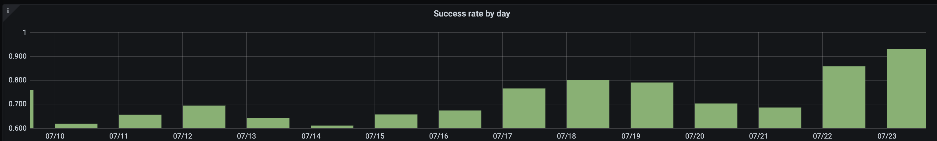
Claims and Appeals
TEAM REPRESENTATIVE: Ronnie / OCTO-DE LEAD: Matt
Insights:
(Data from July 2021)
Findability (526ez) Intro Page – Pageviews 113k (89k unique)
Service completion - Submissions
(Data from last 7 days)
Form 526: 13k
- EVSS accepted 10k
- 7.9 submitted, 6.9 accepted!
BDD: 203
HLR: 812 (13% )
Mission: : Provide Veterans and service members a simple and fast way to file disability claims, decision reviews, appeals, and to access the status of any of their VA benefits.
.
Original Claims - Form 526ez
Usability Test next week
Submissions for Veterans with guard/reserve obligations (tentative resolution)
PTSD (on hold pending availability of VADIR data from VA Profile)
Disability Wizards
526 wizard move complete
Notice of Disagreement (NOD)
Finalizing content modifications & contact info page updates
Higher Level Review (HLR)
Page refresh tasks prioritized
Claims Status Tool (CST)
Tech Discovery
Dependencies, blockers
NOD - awaiting revised opt-in language
VADIR data availability (VA Profile)
Q&A:

Slide 39

Apps Team: Debt Resolution
Matt S. | Leah K. | Linda Li
 | Debtman Rewrite
 | Kick-off
 | Design Intent
 | Analytics
 | I.A.
 | Usability Prep
 | Research Review
 | Staging
 | Contact Center Review
 | 508 Review
 | Post Launch
 | Debt Resolution (FSR)
 | Kick-off
 | Design Intent
 | Analytics
 | I.A.
 | Usability Prep
 | Research Review
 | Staging
 | Contact Center Review
 | 508 Review
 | Post Launch
Medical Co-pays
 | Kick-off
 | Design Intent
 | Analytics
 | I.A.
 | Usability Prep
 | Research Review
 | Staging
 | Contact Center Review
 | 508 Review
 | Post Launch
Medical Co-pay
IA In progress
Started Analytics
Mid-Point Review in progress
Completed IA Feedback
BE data mapping
FSR/Debt letters
Fixing bugs/Improving features
Exploring pre-prod environment option for end to end testing
 | Live 1/4/2021. We are in iteration 3 | Synthesis Complete. wireframes, user journeys -current sprint in prep for early usability |  | Awareness
 | Looking to retire debtman by 8/1 | IA in progress Analytics in progress Midpoint review in process MCP API in process |  | Dependencies
 |  |  |  | Blockers

Slide 40
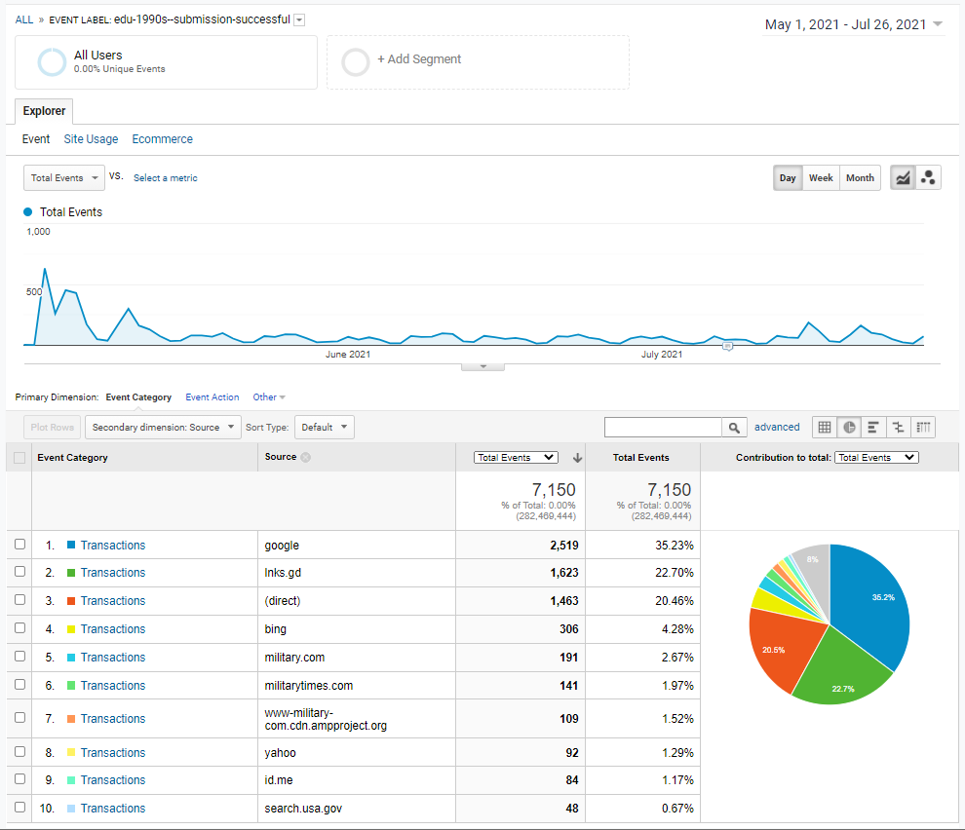


Education Application Team
TEAM REPRESENTATIVE: Amy Knox / OCTO-DE LEAD: Matt Self
Insights: VRRAP Submissions
Mission: Creating easy to use experiences that connect Veterans and their beneficiaries with VA education benefits
GI Bill Comparison Tool Redesign
Development: Mobile Location Search; Comparison View
Design: Mobile profile pages
Research: Profile page testing synthesis
Beta release testing planning
GI Bill Comparison Tool Maintenance
Launch “In-state tuition URL” (Monday, 7/26)
Education Forms Maintenance – Updates per Isakson Roe Legislation
VA Form 22-5490 updates to production (Monday, 7/26)
Dependencies, blockers
Q&A:
TBD
VRRAP submissions are increasing in July after tapering off after its initial launch in May.

Slide 41
Announcements

Slide 42
Announcements
OCTO-DE LEADERSHIP
Announcement:
-
Q&A:

Slide 43
Team of Teams Protocol

Slide 44
How to Team of Team
Slack Elizabeth (Liz) Callaghan to get added to the Team of Teams agenda and calendar event
Using the template and guidance herein, create a slide with high level updates each week about the products your team is actively working on.
Every week before Tuesday @10:00 AM ET, Slack your team’s slide to Liz Callaghan
Every Tuesday @ 12 PM ET, have one representative from your team attend the meeting to:
Present your team’s updates to the group
Note down applicable updates from other teams, and share w/your team for awareness, discussion, and/or follow-up

Slide 45
Guidance for Team of Teams Slides

Slide 46
Keep it high level – don’t get too granular
We don’t need to know how many participants you have scheduled for usability testing, what the status of your stakeholder review is, or what your next API integration task is.
Your updates should help other teams:
Anticipate and plan for their support load or other impacts to their own work
Identify opportunities where cross-collaboration would be beneficial
Your updates should help OCTO-DE:
Understand the big picture of what’s happening across the VA.gov portfolio
Anticipate where their help / guidance / decision may be needed

Slide 47
So… what to write?
Tips to keep your slides short and useful
DO:
Use the provided ToT slide templates so you have the appropriate fonts and formatting
Keep your updates under 1 minute
Use a team name that makes it easy to understand what you do
Indicate what product or service your update is about, and use a product or service name that makes it easy to understand what it does
Indicate what collaboration cycle checkpoint you have next, if applicable
Indicate who an update is intended for, and what (if any) action they should take
Share new patterns, endpoints, or features that other VA.gov products could use or benefit from
Indicate whose help (person or team) you need on blockers and dependencies
DON’T:
Get too technical, remember the audience for this meeting is PMs and OCTO-DE leads.
Mention contract names (unless you have a valid reason to)
Use acronyms without also writing out what it stands for
Use form numbers without also spelling out the name/purpose of the form

Slide 48
Other suggestions
Look at other team slides whose updates you find helpful, and make your style similar
Consider reviewing your updates in advance with your OCTO-DE Lead for feedback on the level of granularity

Slide 49
Template Options

Slide 50
How to interpret the templates
[Bracketed items] are things for you to fill in with your team’s content. Don’t keep the brackets in your updates ;)
Italicized items are instructions that you should delete once you’re done entering your updates.

Slide 51
[Team Name]
TEAM REPRESENTATIVE: [NAME] / OCTO-DE LEAD: [NAME]
Insights:
Below is a framework you can use to communicate meaningful metrics. If this framework doesn’t make sense for your product (like VAMCs, various Platform services, etc), or if you have other interesting insights to share, please feel free to post whatever data or charts/graphs are informing your understanding of your product or service’s value or health.
Findability:
intro pageview trend over time
Service completion
successful submissions trend over time
conversion rate
Ease of use
call center volume trend over time
avg time to complete
Customer satisfaction
CSAT score
Mission: [mission description] collaborate with your OCTO-DE Lead to align on one short sentence describing your team’s mission and paste it here.
[Heading]
[Update]
[Heading]
[Update]
Dependencies, blockers
[Dependency or Blocker]: [update]
Q&A:
TBD
Any launches to announce? Copy and paste this celebration icon
next to the update!

Slide 52
[Team Name]
TEAM REPRESENTATIVE: [NAME] / OCTO-DE LEAD: [NAME]
Insights:
Below is a framework you can use to communicate meaningful metrics. If this framework doesn’t make sense for your product (like VAMCs, various Platform services, etc), or if you have other interesting insights to share, please feel free to post whatever data or charts/graphs are informing your understanding of your product or service’s value or health.
Findability:
intro pageview trend over time
Service completion
successful submissions trend over time
conversion rate
Ease of use
call center volume trend over time
avg time to complete
Customer satisfaction
CSAT score
Mission: collaborate with your OCTO-DE Lead to align on one short sentence describing your team’s mission and paste it here.
[Heading]
[Update]
Dependencies, blockers
[Dependency or Blocker]: [update]
Q&A:
TBD
[Heading]
[Update]
Dependencies, blockers
[Dependency or Blocker]: [update]
Q&A:
TBD
[Heading]
[Update]
Dependencies, blockers
[Dependency or Blocker]: [update]
Q&A:
TBD
[Heading]
[Update]
Dependencies, blockers
[Dependency or Blocker]: [update]
Q&A:
TBD
Any launches to announce? Copy and paste this celebration icon
next to the update!

Slide 53
Example Update Content

Slide 54
Yes!
No.
Discounted ice cream application (Form 99-482) – staging review coming up, will be using a new alerts pattern - heads up for Design System, and for other VFS teams who may have the same alerts needs.
Form 99-482 – staging review coming up: usability testing complete with 7 users, found a few issues but mostly positive results, fixed all 508 bugs, training for back-of-house employees scheduled for 1/28.
Juniper end-to-end testing tool – launched! VFS teams can now magically erase all product errors. PMs, please fwd the impending Slack post to your engineers to make sure your teams set it up.
Juniper – config files can be updated to enable new error control method for data transmission, making use of error-detection codes, acknowledgment and/or negative acknowledgment messages, and timeouts to achieve reliable data transmission. The receiver should indicate that it has correctly received a data frame.
Carrier pigeon package delivery – need to schedule collaboration cycle kickoff. Doing discovery to determine roadmap for carrier pigeon service to help deliver packages more efficiently than US mail. Need help finding appropriate carrier pigeon contacts within VA, please respond to Slack post if you have tips!
CPPD – market research complete, we have 3 options we’re considering that each provide different benefits. Need to usability test each to determine the appropriate path, but not sure who at VA to contact to get that started.

